Slide 1
Week 2 Update

Slide 2
Questions for Interview
Student Issuing 1) What are the difficulties you mainly face when distributing tickets? 2) Are there anything you prefer to have in the upcoming system?
3) What do you like in the current system of issuing tickets?
Planner/Student Inside 1) How do you usually plan seating arrangement? 2) What are some of the difficulties you have planning? 3) What do you usually have to consider when planning seating arrangement? (limitations/elderlies)
4) What is your flexibility (showing seat wise)
Conflict Handlers 1) What is the most common conflict with user you have to handle? 2) What do you need in the system to prevent these conflicts?

Slide 3
Project Plan

Slide 4
Week 1 & 2
Come up with interview questions for week 2
Look through design thinking phases
Interview Students and Teachers involved in event or event planning and summarize the results
Start designing UI on canvas

Slide 5
Week 3 & 4
Figure out what language to use for development
Start out basic GUI development
Discuss for any limitations or improvements to the project
Work on Documentation for Week 6
Work on presentation for Week 6

Slide 6
Week 5 & 6
Check if GUI is acceptable and start coding functionality (Creating Seats and inputs)
Complete a basic working prototype with basic functionality and work on the presentation
Prototype has to have a GUI and layout and have basic working functions

Slide 7
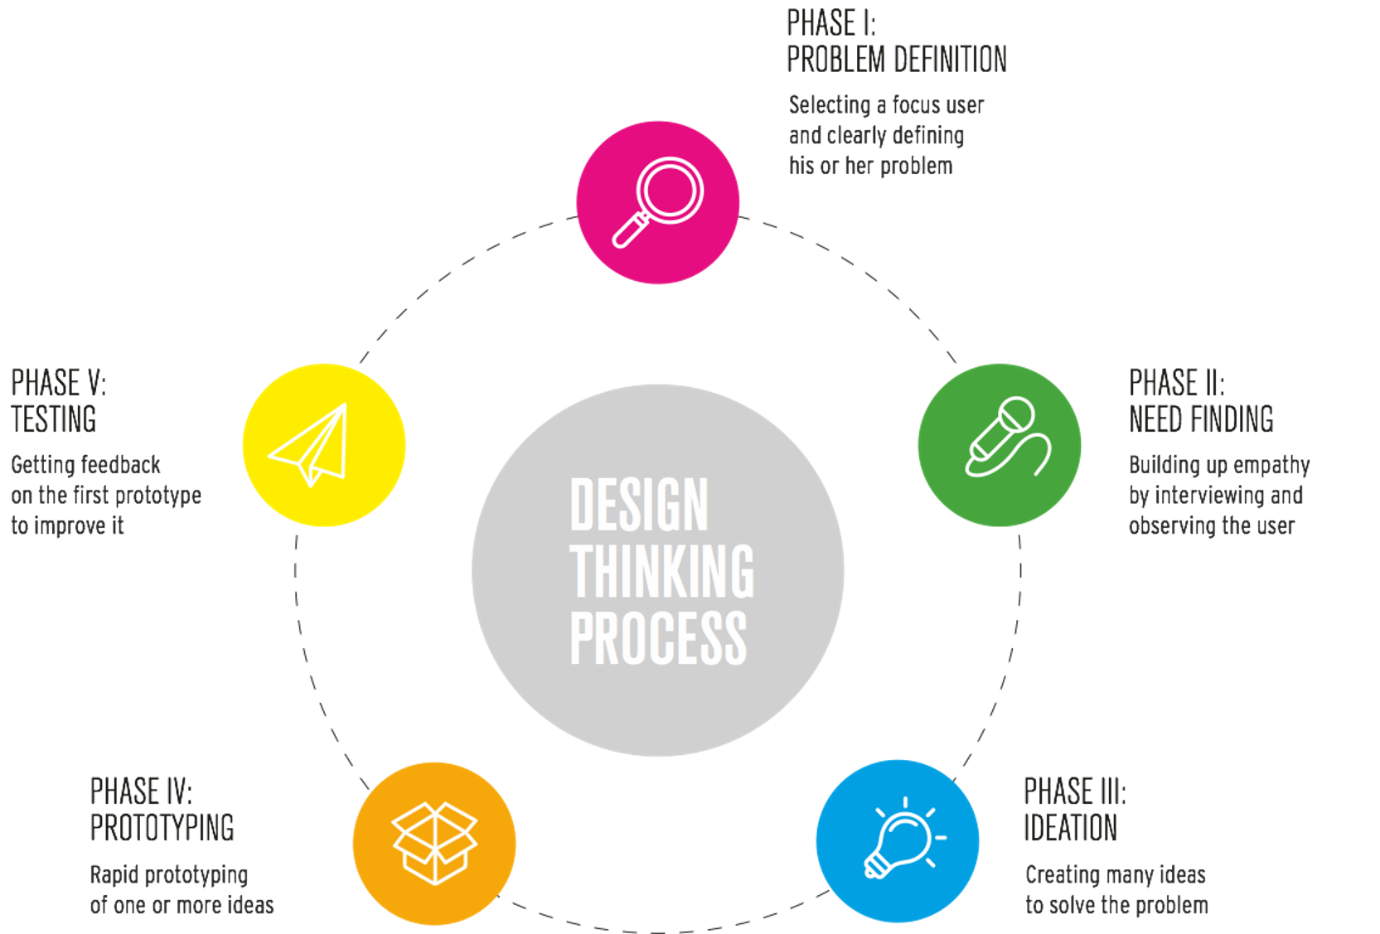
Design Thinking

